Slide 1

Microservices for GE InSight

Slide 2

Solution Approach
Solution Approach
GE wants to define a best practices approach and implement a repeatable model for rapid delivery of microservices in preparation for migrating InSight onto Predix
UST to work with GE to identify and prioritize a set of microservices from the current functionality in InSight
UST to provide GE with a microservices team and execute a sequence of development sprints to deliver the microservices prioritized in the backlog
UST will leverage its experience and industry best-practices based approach for delivering microservices on Cloud Foundry
Determine High-Value Business Capabilities
Decomposition of data and functionality
Delivery of microservices based on business capabilities

Slide 3
UST Global 6D Federated Delivery Approach
Federated Delivery Approach
Define
Develop
Describe
Deploy
Discover
Direct
from a prioritized list of functionality and business capabilities
using micro-service best practices and principles
in API catalog (can be API gateway, API management solution, etc.)
in an automated
via API catalog
using a COE established during initial development
Cloud Infrastructure

Slide 4
Strategy
We won’t create microservices from scratch. Instead, we'll leverage the assets that GE already has. We'll expose smart APIs that leverage most/all existing code as-is
Lift and shift current components onto CF
Create new API layer (using microservices architecture style) that leverages existing code but exposes well crafted developer friendly APIs
Existing UI code does not go thru Microservices layer (uses existing services layers)
Prerequisites
API design
API management layer
CF on AWS
The solution will enable report delivery to external parties (extensible mechanism)*
UST Global solution will be based on consumer driven contracts; anybody with proper authorization will be able to interact with it, so long as they comply with the interface requirements. It will be able to interact with other systems
Based on our knowledge of the InSight system, we have started to outline the API's for the consumers, and administrators
We will start building the above mentioned API's, learn from them, identify patterns and develop reusable components; enabling subsequent iterations to move at optimum pace
The risk/reward strategy, e.g., quality vs. quantity will be determined with GE decision makers and it will be further evaluated and adjusted as needs dictate
Start getting the right resources for the success of this project
This approach provides faster time-to-value and delivers reliable and predictable outcome
* - deferred to phase II

Slide 5
Timelines
Tentative Plan and Timeline
Planning, Resourcing, & On-boarding
Sprint 0: Foundational Readiness
Sprint 1
Sprint 2
Sprint n
Identify and Onboard Team Members
Microservices Reference Arch
Access to Systems and Tools
Microservices Frameworks & Tools Setup
Sprint Planning, Backlog Grooming
Agile team tools setup
Analysis & Design for Early Sprints
First Microservice
Develop, Test and Deploy additional prioritized microservices
Prep & Validate Environment
Team indoctrination – best practices and principles
Increasing velocity
4-5 sprints (3 week iterations)
Time & Material staffing model
UST Global will staff positions based on GE’s needs – can ramp up additional capacity as required

Slide 6
Foundational Readiness Activities
Define Microservices Architecture Architecture Repository Development Standards Tools & Frameworks Performance Architecture Security Architecture Testing Architecture CI/CD Architecture Operational Architecture Create Microservices Reference Implementation Frameworks & Tools Integration Essential Configuration Code Templates Patterns & Practices Recommend CI/CD/DevOps for Microservices Environment setup and configuration SCM infrastructure CI/CD toolchain & pipelines Build/deployment automation DevOps toolchain & pipeline | Establish Quality Management Foundation Unit Testing Tools Integration Testing Tools E2E Testing Tools Code Quality Management Tools Implementation Team Readiness & Ramp-up Indoctrination on Microservices Frameworks, Tools, Process & Methodology Agile team tools setup (JIRA, Confluence) High Level Sprint Planning, Backlog grooming, Sprint Dashboard creation Requirements/Acceptance Criteria definition & refinement for early sprints High Level Analysis, Design, and Test Planning for early sprints
UST will create a Cookbook (instructional manual, lessons learned), to be leveraged and updated during the implementation of additional microservices in later phases.

Slide 7




Recommended Team Structure
Roles and Responsibilities
Microservices Architect
Key Responsibilities
Provide Cloud, Microservice, and Java design and development best practices
Provide Subject Matter Expertise in Microservice development and deployment
1 Resource On-Site supported additionally from UST Cloud Architecture Practice
Technical Product Owner
Key Responsibilities
Iteration planning
Manages and coordinates the backlog and implementation
User Story elaboration
1 Resource On-Site
Software Dev Engineers
Key Responsibilities
Develop defined Microservices
Unit test developed Microservices
Support QA
2-4 Software Development Engineers On-site
SDETS
(QA Software Dev Engineers in Test)
Key Responsibilities
Functional test of Microservices in sprint
Non-functional test of epic product
1-3 Quality Assurance Professionals On-site

Slide 8
Commercials
Commercials
GE Microservices Proposal by Milestone
Phase | Milestone | Total Fees
Phase 1 (Min Team) | 5 sprints (1 Architect, 1 Technical Product Owner, 2 Developers, 1 SDETS) | $ 294,000
Phase 1 (Max Team) | 5 sprints (1 Architect, 1 Technical Product Owner, 4 Developers, 3 SDETS) | $ 474,000
Monthly Burn Post Phase 1 | (1 Architect, 1 Technical Product Owner, 2 Developers, 1 SDETS) | $ 84,280
Monthly Burn Post Phase 1 | (1 Architect, 1 Technical Product Owner, 4 Developers, 3 SDETS) | $ 135,880
* Each sprint duration is 3 weeks ** Monthly rates are based on 172 hours/month. *** Prices above do not include travel expenses and will be billed as actuals. **** The amount represented for Delivery/Warranty is representative based on our current understanding. This figure will be validated/refined at the end of the Sprint 0.
Team Role |  | Hourly Rate
Cloud Development Architect – Onsite |  | $ 180.00
Tactical Product Owner – Onsite |  | $ 85.00
Developer – Offshore |  | $75.00
QA Tester - Offshore |  | $75.00

Slide 9
Indicative Client Case Studies
Sample Clients
Large US Private Healthcare Firm
Top Mobile Communications Company
Design, develop, validate, and implement first phase of microservices in an effort to migrate from a monolithic SOA architecture to an agile microservice enabled architecture.
Industry Leading Credit Rating Company
Develop microservices Best Practices to be implemented by the architecture CoE
Develop proof of concept web application using PaaS, microservices, and Container technology
Design and implement prototype architecture to enable rapid development for client customers
Develop microservices in Java using the Spring framework
Architecture components include Pivotal Cloud Foundry and Docker Containers to deliver to a cloud environment
Utilize industry leading API management platform

Slide 10
Appendices

Slide 11
Microservices Components & Frameworks

Slide 12
Microservices Solution Components
Architecture
Operations
Execution Model
Tools & Frameworks
Event Logging
Agile Execution Model
Centralized Configuration
Instrumentation
Foundational Readiness
Event-Driven Architecture
Monitoring
Reference Implementation
Service Registration
Automation
Patterns & Practices
Service Discovery
Test Automation
Program Management
Smart Service Client
Build Automation
Project Governance
Reactive Services
Deployment Automation
Packaging & Deployment
Self-Service Provisioning
System Qualities
Performance
Scalability
Availability
Security
Cloud-Ready

Slide 13
Spring Cloud Microservices Frameworks
Capability | Framework
Java - Foundational
Core Foundational | Spring Framework
IoC Container | Spring IoC
Enterprise Integration | Spring Integration
Relational ORM | Hibernate
Advanced Persistence (NoSQL, Big Data) | Spring Data
Aspect-Oriented Programming (AOP) | Spring AOP
Runtime | Java EE 7
Dependency Management | Maven
IDE | Eclipse
Capability | Framework
Java - Microservices Foundationals
Core Cloud (Abstraction, Autoconfig & Binding) | Spring Cloud
Microservices Framework | Spring Cloud Netflix (Spring Cloud core implemented via Netflix's OSS components)
Service Registration & Service Discovery | Eureka
Circuit Breaker | Hystrix
Declarative REST Client | Feign
Client Side Load Balancer | Ribbon
External Configuration | Archaius (based on Apache Commons Configuration)
Routing & Filtering | Zuul
Reverse Proxy | Zuul
Log Aggregation | Turbine
Capability | Framework
Java – Security
Core Security | Spring Security
OpenID | Spring Security Core
OAuth | Spring Security OAuth
SAML | Spring Security SAML Extension
Capability | Frameworks
Java - Testing
Test Development | Spring Test
Test Execution Environment | Junit

Slide 14
Refactoring to Microservices

Slide 15
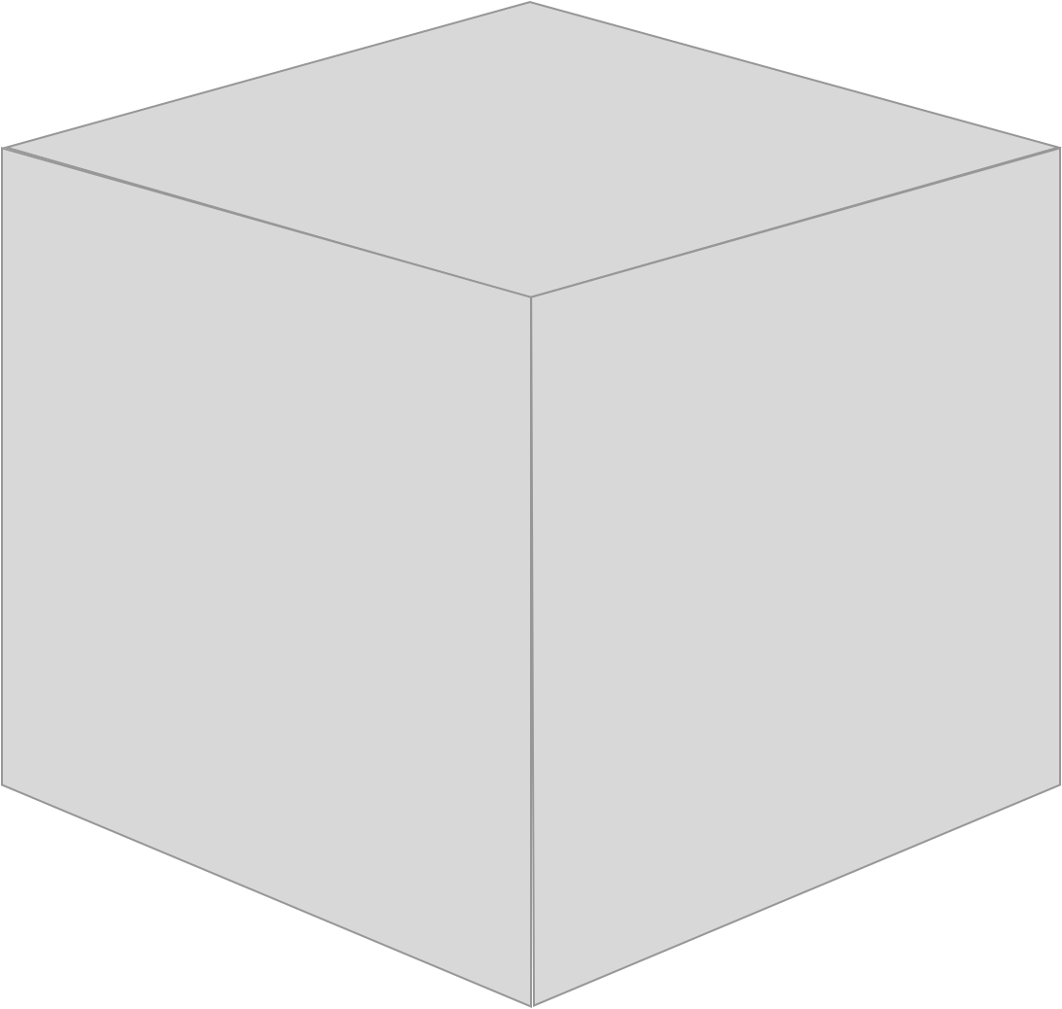
Deployment monolith

Slide 16
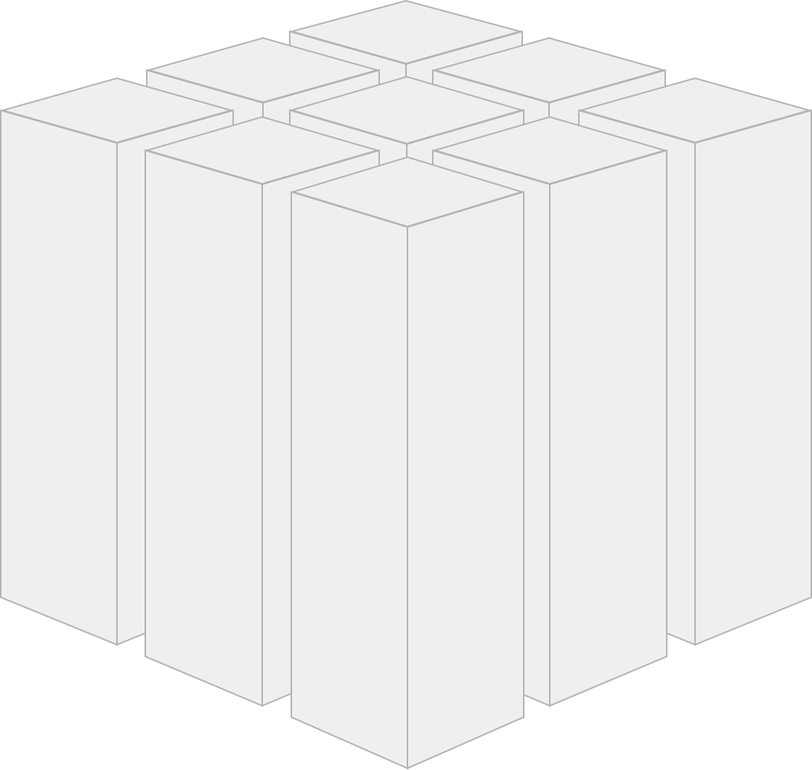
Cut Deployment monolith along domains …

Slide 17
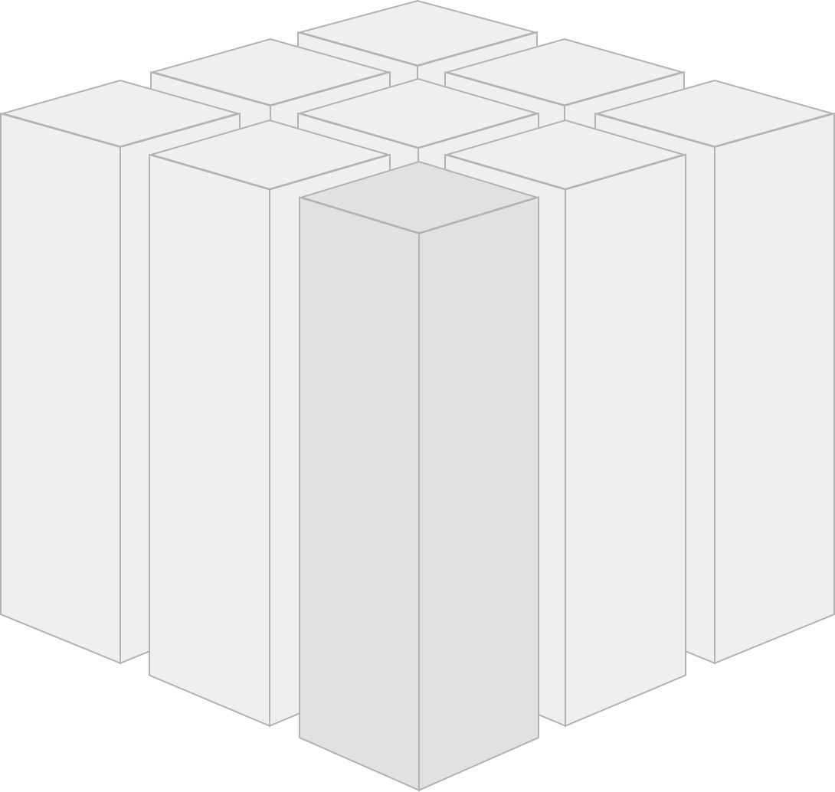
… wrap domain in
separate web application …

Slide 18

Self contained System (SCS) – individually deployable

Slide 19
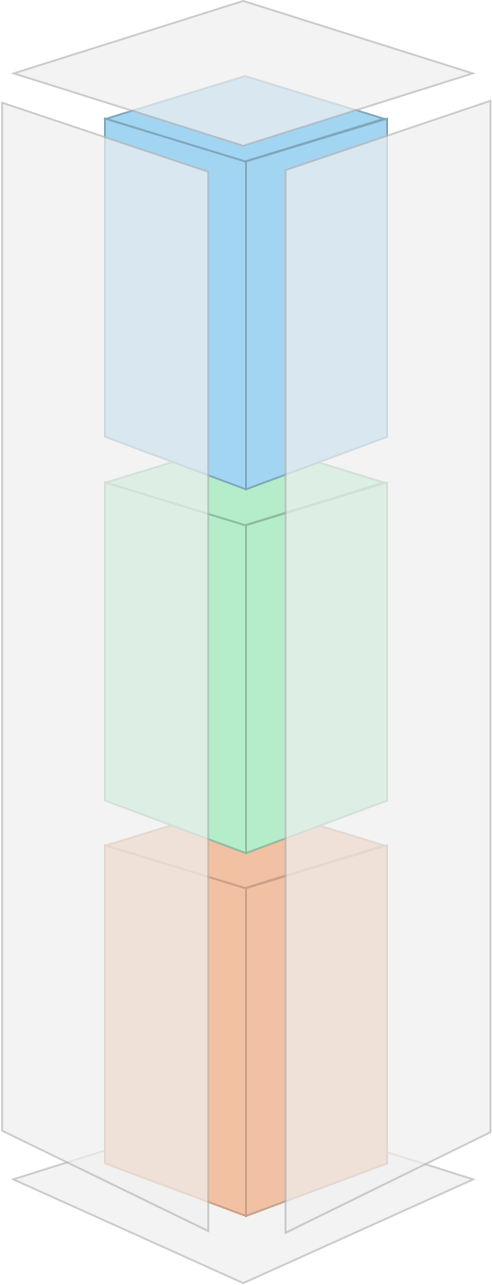
SCS =
user interface+ business logic+ data storage

Slide 20


Self-contained systems enable the development of a domain by a single team
– no coordination
Single Team =
UI+Logic+Database

Slide 21
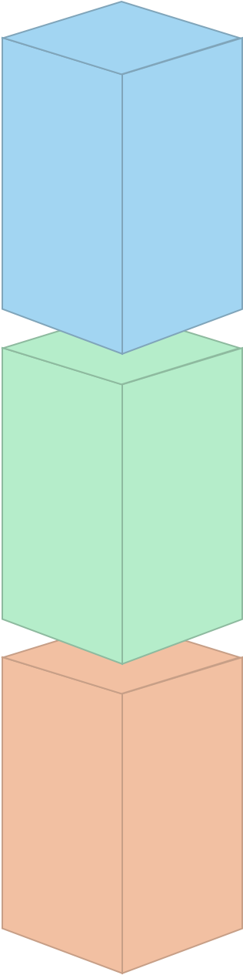
Technical decisions can be made independently from other systems (programming language, frameworks, tooling, platform)

Slide 22

Web user interface

Slide 23

optional API e.g. for mobile

Slide 24
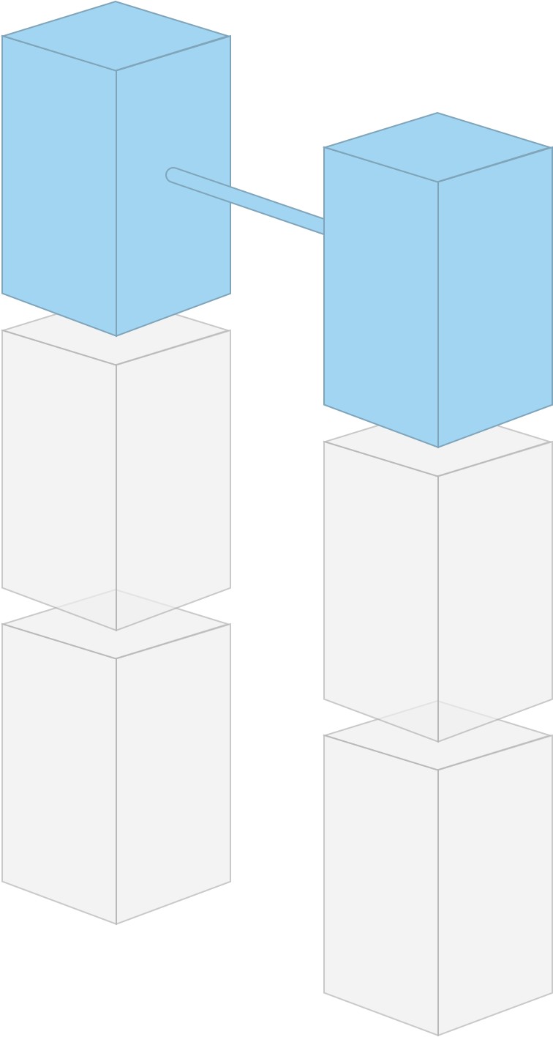
Self-contained Systems
should be integrated in the web interface

Slide 25
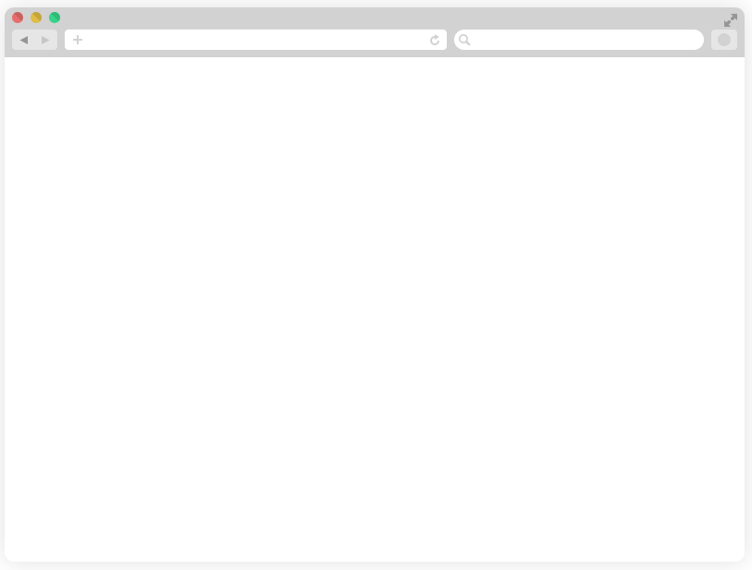


System 1 System 2
Hyperlinks to navigate between systems.

Slide 26




System 1 System 2
Dynamic inclusion of content served by another application

Slide 27

Logic only shared over a well defined interface.

Slide 28

Business logic can consist of
microservices

Slide 29
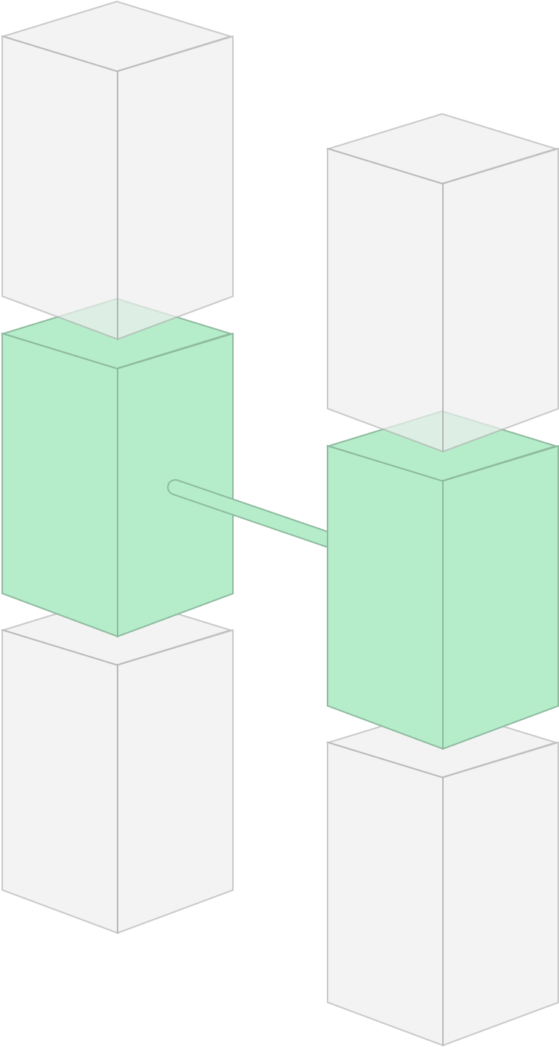
Avoid synchronous remote calls

Slide 30
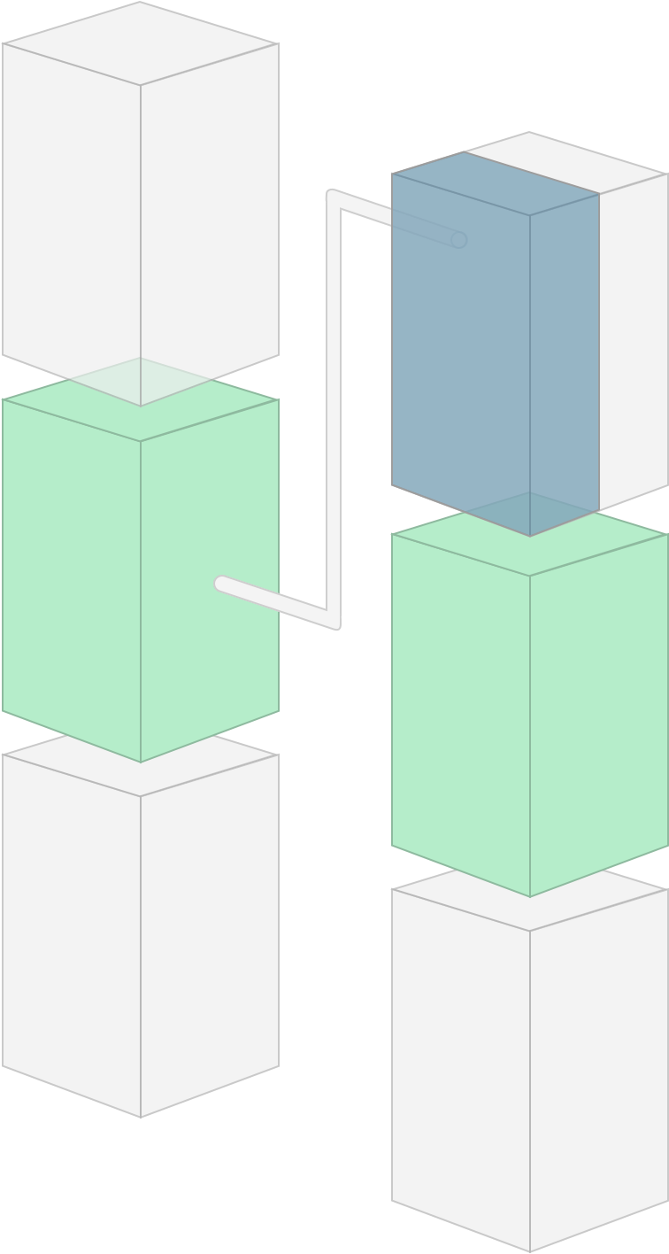
Remote API calls should be
asynchronous

Slide 31

Every SCS brings its own data storage with its own (potentially redundant) data

Slide 32
Self-Contained Services enable greater Agility
> Self Contained Services
> less dependencies
> less delays
> less communication about functionalities
> Technological freedom
> less communication about technologies
> Independent releases
> no need to coordinate releases

Slide 33
Migration Strategy

Slide 34
Account Management
Sites
Account Activity
Trends
Controllers
Alarms
Analytics
Assets
Comments
Reports Management
Annotations
Report Generation
Parameters
Missed Updates
Fleet Dashboards
Charts
Inventory
Line Chart
Pie
…
Value Projects
Perf History
Alarms
Files
Coord. Phosphate
Health Ind.
Users
…
Roles

Slide 35
GET /accounts
GET /account/{accountId}
GET /account/{accountId}/activity
GET /account/{accountId}/activity?type=“alarm”
GET /account/{accountId}/activity?type=“missedUpdate”
GET /account/{accountId}/activity?type=“annotation”
GET /account/{accountId}/activity?type=“comment”
GET /account/{accountId}/activity/comment/{commentId}
POST…
PUT…
DELETE…

